Slide 1

Restaurant Recommendation System
Presented by:
Pd18_067 Harshal Chopade
Pd18_006 Mohammad Ashraf
Pd17_030 Abhishek Mali
Pd18_091 Om Mahalle

Slide 2
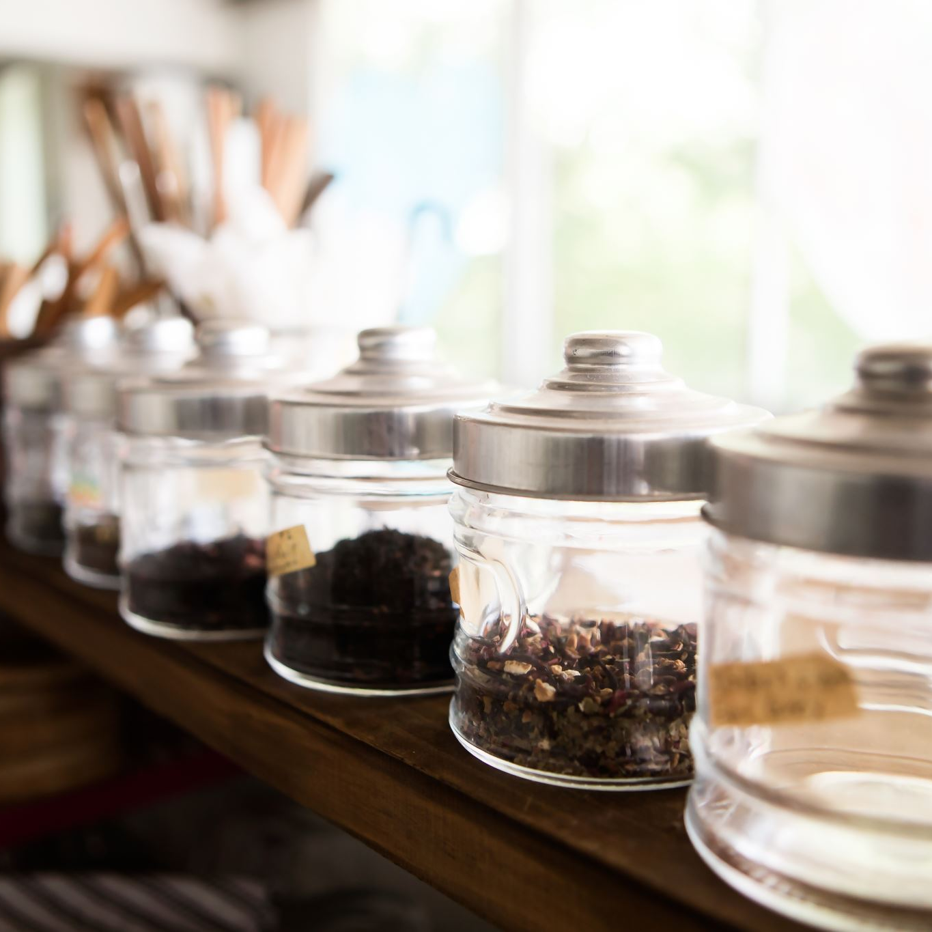
Primary Objective
To collect data from the food delivery platform SWIGGY using web scraping and analyze the data to generate insights and recommendations for the end user. This may involve analyzing restaurant information, such as ratings, cuisine, and pricing.

Slide 3

Goals:
To develop a recommendation model that can provide valuable insights for someone who wants to open a restaurant in Bangalore.
The ultimate goal is to help the user make informed decisions about their restaurant's cuisine, location, and pricing strategy to maximize their chances of success in the Bangalore market.

Slide 4
Approaches to complete the goals
Web Scrapping of Data from swiggy.com
Data Pre-processing – Data cleaning & Manipulation
Model Creation using Random Forest Classifier
Webpage creation to visualise the recommendation

Slide 5
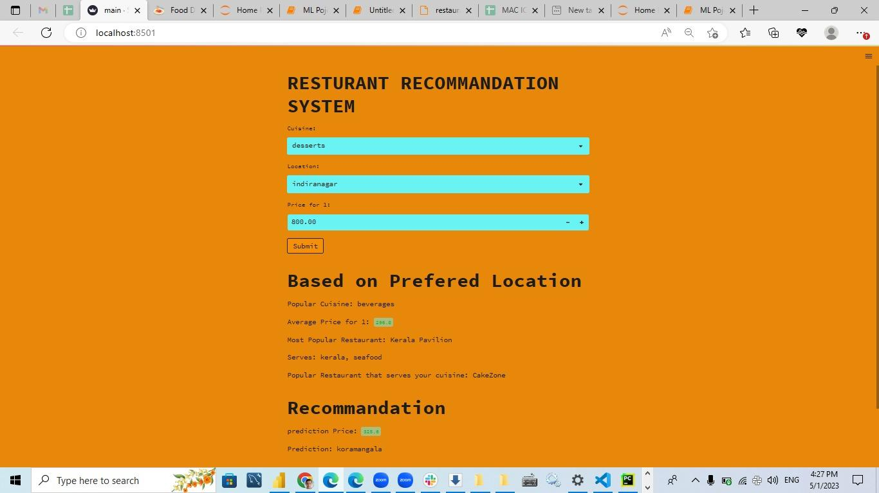
Webpage Working
Cuisine Input
Location Input
Reverting the input to the model
Price Input
Output 1
Output 2

Slide 6
Webpage to generate recommendation

Slide 7
Conclusion
Our machine learning recommendation model can help restaurant owners open a successful restaurant in Bangalore by considering cuisine, location, and price preferences.
In this study, we explained our model's inputs and outputs and how it can assist in making informed decisions. With our model, both seasoned restaurateurs and first-time entrepreneurs can benefit from valuable insights.

Slide 8
Challenges Faced:
Collecting data from single platform for different restaurants was time consuming. Getting data well and consistent across different sources requires careful data cleaning and processing.
Needed extensive research and data analysis to ensure that the model's recommendations are accurate and relevant to the target audience.
Lesson Learned:
Web Scrapping can be effective tool for collecting larger amount of information but it requires careful consideration of legal & ethical issues.
Data Cleaning & processing are important steps in data analysis, investing time & effort can prevent many headaches.
Good data visualization is essential to convey understanding to stakeholders or clients.

Slide 9
Future Scope:
Expand analysis in other region
Incorporate external factors: External factors such as weather, events, or holidays
Collaborate with restaurants or food delivery platforms
Incorporate more data sources

Slide 10

Thank You...

